Slide 1
Professional English
Class 5: Navigating Risks, Constraints, and Project Impact

Slide 2
Agenda
1-Hour Lesson Plan Overview

Slide 3



1-Hour Lesson Structure
Warm-up & Review
New Concepts
Interactive Practice
15-35 mins: Introduction to Class 5 vocabulary with definitions and corporate examples.
0-15 mins: Reviewing vocabulary from Classes 1-4. Reinforcing previous knowledge.
35-60 mins: Real-world scenarios, speaking activities, and sentence building.

Slide 4

Quick Recap: Classes 1-4
Before diving into today's lesson, let's review our progress:
•
Class 1: Actually, Eventually, Support, Responsible For, Implement
•
Class 2: Question, Status, Deadline, Ownership, Blocker
•
Class 3: Commitment, Requirement, Stakeholder, Dependency, Escalation
•
Class 4: Bandwidth, Roadmap, Deliverable, Workaround, Alignment
Tip: Use these actively in your daily stand-ups to sound more professional.

Slide 5
Today's Focus: Class 5
Risk, Assumption, Constraint, Impact, Mitigation

Slide 6


1. Risk & Assumption
•
Risk: A possible future problem that could negatively affect the project.
•
Example: "There is a risk of delay if the vendor is late."
•
Assumption: Something believed to be true without proof; the baseline for your plan.
•
Example: "Our assumption is that the vendor will deliver on time."

Slide 7

2. Constraint & Impact
•
Constraint: A limitation or restriction on your project (usually time, budget, or scope).
•
Example: "Budget is our biggest constraint right now."
•
Impact: The strong effect or consequence of an event or decision.
•
Example: "The server outage had a significant impact on sales."

Slide 8

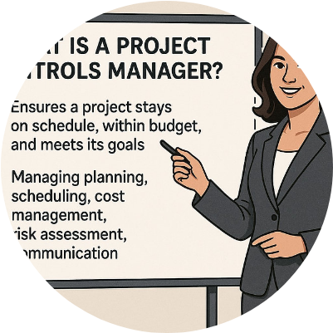
3. Mitigation
Action to Reduce Risk
Mitigation is the specific plan or action you take to lessen the severity, impact, or probability of a risk.
Example: "Additional testing is our mitigation plan to avoid software bugs upon release."
In business meetings, showing a mitigation plan demonstrates proactive leadership and problem-solving skills.

Slide 9
Contextual Practice: The Delayed Project
Assumption: We assumed the design team would finish the mockups by Tuesday.
Constraint: However, their limited bandwidth is a major constraint.
Risk: Because of this, there is a risk that the development phase will be delayed.
Impact: The impact of a delay is that we miss the client's strict deadline.
Mitigation: Our mitigation is to reassign two developers to help the design team finalize the assets.

Slide 10
Speaking Activity: Your Turn
Step 1: Identify
Step 2: Present
Think of a current or past project at your job.
Explain the situation to the class.
Identify one major Risk and one Constraint that your team faced during the process.
Clearly state what the potential Impact was, and explain your Mitigation strategy to solve it.

Slide 11

Review & Summary
Mastering Project Vocabulary
Today we covered essential language for managing project uncertainties: Risk, Assumption, Constraint, Impact, and Mitigation.
Using these specific terms will help you communicate challenges clearly and present yourself as a proactive, solutions-oriented professional in any business setting.

Slide 12
Questions?
Thank you for your active participation today.
Keep practicing your new vocabulary!

Slide 13




Image Sources
https://www.certified-nets.com/wp-content/uploads/2025/10/collaborative-it-team-discussing-kpi-dashboards-orange-purple-accents-f83b77b5-16a6-4a14-9d44-4593c1b04c45-800x1200.jpg
Source: www.certified-nets.com
https://www.transcendentseekers.com/wp-content/uploads/2025/11/Team-collaborating-at-a-whiteboard-during-a-participative-leadership-workshop-1024x559.jpg
Source: www.transcendentseekers.com
https://static.wixstatic.com/media/b9cef4_e6d2f31b36324e498a1fbad2f7f7b03f~mv2.jpg/v1/fill/w_1000,h_667,al_c,q_85,usm_0.66_1.00_0.01/b9cef4_e6d2f31b36324e498a1fbad2f7f7b03f~mv2.jpg
Source: www.projectmanagertemplate.com
https://images.presentationgo.com/2025/06/business-handshake-partnership.jpg
Source: www.presentationgo.com

